Slide 1

INTRODUCTION TO
JAVA

Slide 2
GETTING STARTED
INTRODUCTION TO JAVA: FIRST STEPS
3
▸ Toolbox
▸ JDK 19 https://www.oracle.com/java/technologies/javase/jdk19-archive-downloads.html
▸ Intellij IDEA Community Edition: https://www.jetbrains.com/idea/download/
▸ Git: https://git-scm.com/downloads
▸ Collaboration
▸ GitHub: https://github.com/
▸ Communication
▸ Telegram

Slide 3
JAVA OVERVIEW

Slide 4
Java and evolution
INTRODUCTION TO JAVA: FIRST STEPS
15
JDK Альфа и Бета (1995)
JDK 1.0 (23 января 1996 г.)
JDK 1.1 (19 февраля 1997 г.)
J2SE 1.2 (8 декабря 1998 г.)
J2SE 1.3 (8 мая 2000 г.)
J2SE 1.4 (6 февраля 2002 г.)
J2SE 5.0 (30 сентября 2004 г.)
Java SE 6 (11 декабря 2006 г.)
Java SE 7 (28 июля 2011 г.)
Java SE 8 (18 марта 2014 г.)
Java SE 9 (21 сентября 2017 г.)
Java SE 10 (20 марта 2018 г.)
Java SE 11 (сентябрь 2018 г.)
Java SE 12 (март 2019 г.)
Java SE 13 (сентябрь 2019 г.)
Java SE 14 (март 2020 г.)
Java SE 15 (сентябрь 2020 г.)
Java SE 16 (март 2021 г.)
Java SE 17 (сентябрь 2021 г.)
Java SE 18 (март 2022 г.)
Java SE 19 (осень 2022 г)
James Gosling, Mike Sheridan, Patrick Naughton
Green Team
Greentalk .gt
Oak
Java
Sun Microsystem
JDK 1.0 был выпущен 23 января 1996 года.
Oracle Corporation

Slide 5
INTRODUCTION TO JAVA: LANGUAGE OVERVIEW
INTERNAL WORKFLOW
Java Code
public class JavaLesson { void meetAndGreet() {}
}
Java Development Kit (JDK)
Java Byte Code
Passed to
Compiles
Java Compiler
Java Runtime Environment (JRE)
Java Virtual Machine (JVM)
Just-in-Time Compiler (JIT)
Executes
Transferred

Slide 6
JAVA COMPONENTS: JVM & JRE & JDK
INTRODUCTION TO JAVA: LANGUAGE OVERVIEW
11
▸ Виртуальная машина Java (JVM) — это абстрактная вычислительная машина, которая позволяет компьютеру запускать программу Java.
▸ Java Runtime Environment (JRE) — это программный пакет, содержащий все необходимое для запуска программы Java. Он включает в себя реализацию виртуальной машины Java вместе с реализацией библиотеки классов Java.
▸ Комплект для разработки Java (JDK) представляет собой расширенный набор JRE и содержит инструменты для программистов на Java, например. компилятор Java

Slide 7
JAVA COMPONENTS: JVM & JRE & JDK
INTRODUCTION TO JAVA: LANGUAGE OVERVIEW
11
JVM (Java Virtual Machine) - это виртуальная машина Java - основная часть исполняющей системы Java, так называемой Java Runtime Environment (JRE). Виртуальная машина Java исполняет байт-код Java, предварительно созданный из исходного текста Java-программы компилятором Java (javac). JVM обеспечивает платформо-независимый способ выполнения кода. Программисты могут писать код не задумываясь, как и где он будет выполняться.
JRE (Java Runtime Environment) - это минимальная реализация виртуальной машины, необходимая для исполнения Java приложений, без компилятора и других средств разработки. Состоит из виртуальной машины и библиотек Java классов.
JDK (Java Development Kit) - это комплект разработчика приложений на языке Java, включающий в себя компилятор, стандартные библиотеки классов Java, примеры, документацию, различные утилиты и исполнительную систему JRE.

Slide 8
JAVA COMPONENTS: JVM & JRE & JDK
INTRODUCTION TO JAVA: LANGUAGE OVERVIEW
11

Slide 9
OBJECT-ORIENTED PRINCIPLES OVERVIEW

Slide 10

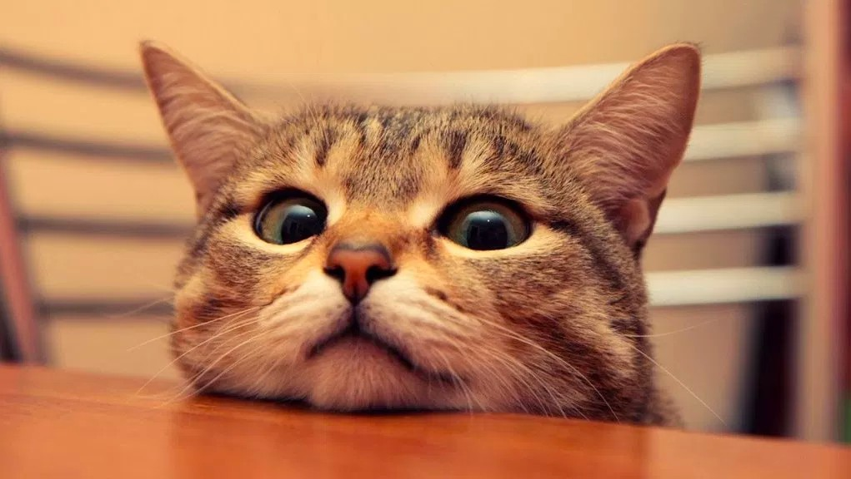
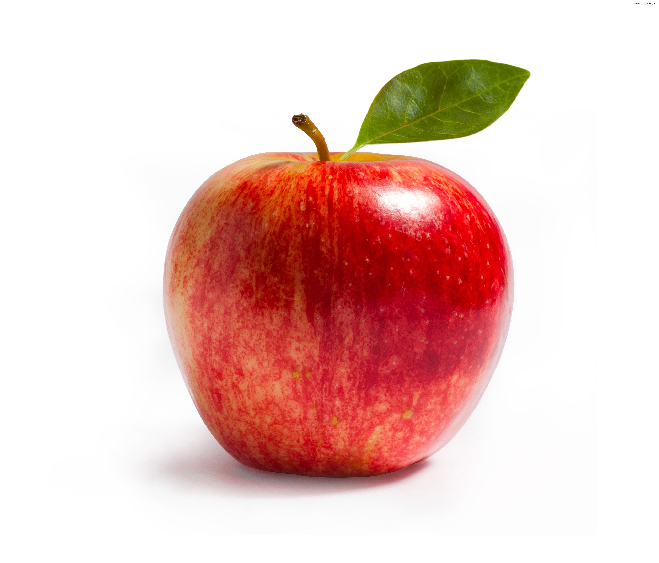

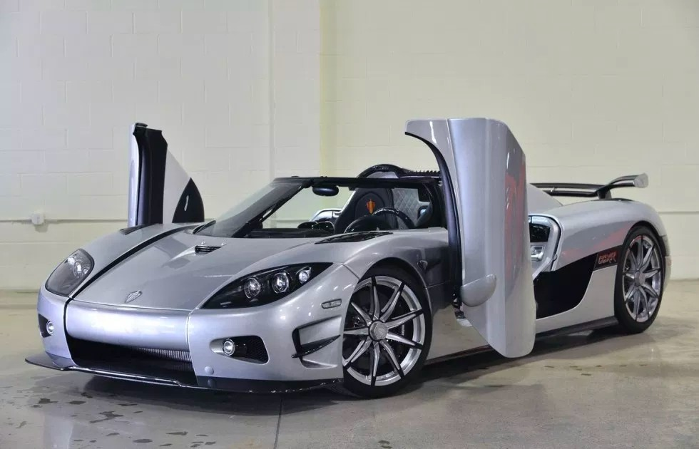
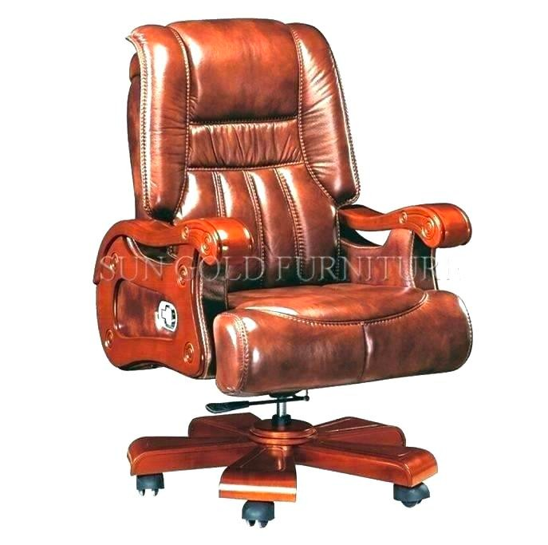
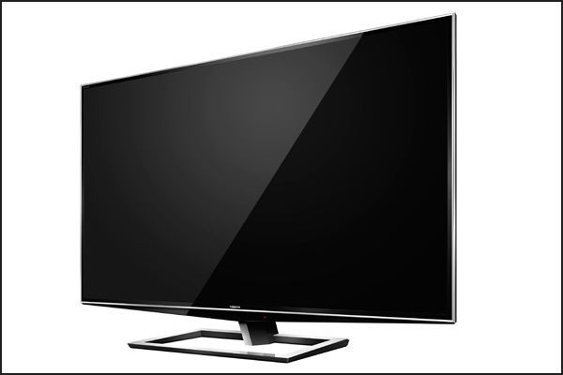
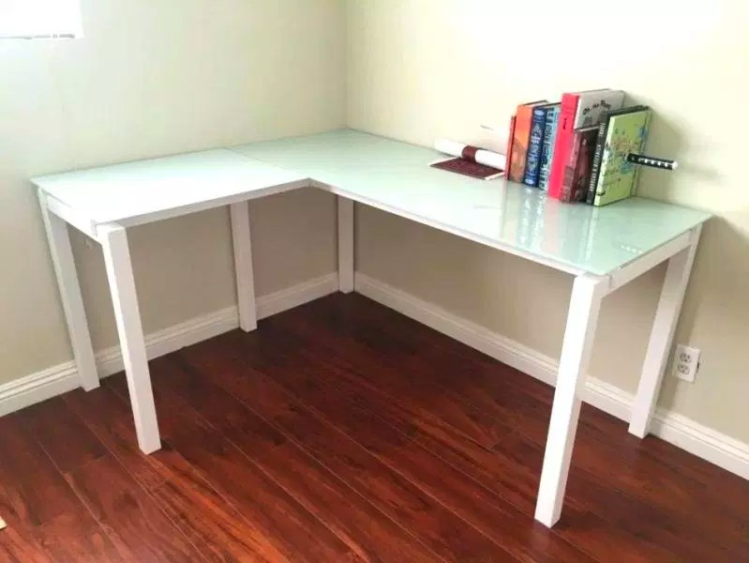
WHAT IS AN OBJECT?
INTRODUCTION TO JAVA: OBJECT-ORIENTED PARADIGM
17
▸ Just look around... Everything is an object!

Slide 11
CHARACTERISTICS
INTRODUCTION TO JAVA: OBJECT-ORIENTED PARADIGM
18
▸ Every object share two characteristics:
▸ Object has some sort of state
▸ Object might have behaviour

Slide 12








OBJECT BREAKDOWN: DOG
INTRODUCTION TO JAVA: OBJECT-ORIENTED PARADIGM
19
State
Color
Behaviour
Run
Name
Bark
Hungry
Eat
Breed
Sleep

Slide 13
OBJECT BREAKDOWN: BOOK
INTRODUCTION TO JAVA: OBJECT-ORIENTED PARADIGM
20
State
Author
Behaviour
Open
Title
Close
Genre
Turn page
Pages
Bookmark

Slide 14
ALGORITHMS

Slide 15
DEFINITION OF AN ALGORITHM
INTRODUCTION TO JAVA: ALGORITHMS
22
▸ An algorithm is a procedure or formula for solving a problem, based on conducting a sequence of specified actions
▸ In mathematics and computer science, an algorithm usually means a small procedure that solves a recurrent problem
▸ A computer program can be viewed as an elaborate algorithm

Slide 16

WRITING FIRST PROGRAM

Slide 17
INTRODUCTION TO JAVA: WRITING FIRST PROGRAM
40
TASK 0: OBJECTIVES
1. Print "Hello, Java World" text to the console

Slide 18

WRITING OUTPUT TO THE CONSOLE

Slide 19
WRITING OUTPUT TO THE CONSOLE: SYNTAX
INTRODUCTION TO JAVA: WRITING OUTPUT TO THE CONSOLE
29
▸ Write to the console content of the "args" variable
System.out.println(args);
▸ Write to the console directly without variable
System.out.println("Hello World");

Slide 20
WRITING OUTPUT TO THE CONSOLE: EXAMPLE
INTRODUCTION TO JAVA: WRITING OUTPUT TO THE CONSOLE
30
Printing Variable Printing directly
int a = 10; String b = "Hi"
System.out.println(a); System.out.println(b);
System.out.println(374); System.out.println("A");
10
Hi
374
A
Process finished with exit code 0
Process finished with exit code 0

Slide 21
WRITING OUTPUT STATEMENT BREAKDOWN
INTRODUCTION TO JAVA: WRITING OUTPUT TO THE CONSOLE
31
Class with standard output, input and error
output streams
Function that writes argument to the specified stream
System.out.println("Hello World");
Argument to be written to the stream
Inner class that helps to specify stream flow direction

Slide 22

VARIABLES OVERVIEW

Slide 23
VARIABLES DEFINITION
INTRODUCTION TO JAVA: VARIABLES OVERVIEW
3
▸ Variable is a named placeholder that
▸ Stores data
▸ Describes what type of data you can store
▸ Describes size or amount of data it can store

Slide 24








VARIABLES RELATIONSHIP WITH OBJECTS
INTRODUCTION TO JAVA: VARIABLES OVERVIEW
4
State
Describes
Name
Text
Age
Whole number
Weight
Fractional number
Race
Enumeration
Hungry
Yes/No Question

Slide 25
DATA TYPE CATEGORIES
INTRODUCTION TO JAVA: VARIABLES OVERVIEW
5
▸ Primitive values
▸ Integer: byte, short, int, long (e.g. 3, 7, 42, 2018)
▸ Fractional: float, double (e.g. 3.1415, 2.7, 19.0)
▸ Logical: boolean (true or false)
▸ Textual: char (e.g. a, b, c, x, y, z)
▸ Reference values
▸ Everything else

Slide 26
PRIMITIVE DATA TYPES IN DEPTH: INTEGER
INTRODUCTION TO JAVA: VARIABLES OVERVIEW
6
Name
Assignable Values
Space
byte
-128 … 127
1 byte
short
-32,768 … 32,767
2 bytes
int
-2³¹… 2³¹ -1
4 bytes
long
-2⁶³ … 2⁶³ -1
8 bytes

Slide 27
PRIMITIVE DATA TYPES IN DEPTH: FLOATING POINT
INTRODUCTION TO JAVA: VARIABLES OVERVIEW
7
Name
Precision
Space
float
Single
4 bytes
double
Double
8 bytes

Slide 28
PRIMITIVE DATA TYPES IN DEPTH: LOGICAL
INTRODUCTION TO JAVA: VARIABLES OVERVIEW
8
Name
Assignable Values
Space
boolean
true / false
1 byte

Slide 29
PRIMITIVE DATA TYPES IN DEPTH: TEXTUAL
INTRODUCTION TO JAVA: VARIABLES OVERVIEW
9
Name
Assignable Values
Space
0 ('\u0000') …
65535 ('\uffff')
char (unicode)
2 bytes

Slide 30

DEFINING VARIABLES IN JAVA CODE

Slide 31
VARIABLE DECLARATION IN JAVA: SYNTAX
INTRODUCTION TO JAVA: VARIABLE DECLARATION SYNTAX
11
▸ Variable declaration without value assignment
type name;
▸ Variable declaration with value assignment
type name = value;

Slide 32
VARIABLE DECLARATION IN JAVA: EXAMPLE
INTRODUCTION TO JAVA: VARIABLE DECLARATION SYNTAX
12
▸ Variable declaration without value assignment
int age;
▸ Variable declaration with value assignment
int age = 22;

Slide 33
VARIABLE DECLARATION BREAKDOWN
INTRODUCTION TO JAVA: VARIABLE DECLARATION SYNTAX
13
Variable data type
Assignment operator
int age = 22;
End of statement
Variable value
Variable name

Slide 34
MORE EXAMPLES
INTRODUCTION TO JAVA: VARIABLE DECLARATION SYNTAX
14
byte numberOfWheels = 4;
short selfEsteem = -1;
int studentsGraduated = 1001;
long height = 80; float pie = 3.14f; double weight = 70.5; boolean hungry = true;
char lastLetterOfTheAlphabet = 'Z';

Slide 35

ARITHMETIC OPERATORS

Slide 36
ARITHMETIC OPERATORS OVERVIEW
INTRODUCTION TO JAVA: ARITHMETIC OPERATORS
20
Operator
Operation
+
Addition
-
Subtraction
/
Division
*
Multiplication
%
Remainder

Slide 37
OPERATORS BREAKDOWN: ADDITION
INTRODUCTION TO JAVA: ARITHMETIC OPERATORS
21
Integer numbers
Fractional numbers
int | a | = | 10; | double | x | = | 1.5;
int | b | = | 30; | double | y | = | 2.7;
int result = a + b;
result == 40
double result = x + y;
result == 4.2

Slide 38
OPERATORS BREAKDOWN: SUBTRACTION
INTRODUCTION TO JAVA: ARITHMETIC OPERATORS
22
Integer numbers Fractional numbers
int | a | = | 30; | double | x | = | 5.4;
int | b | = | 20; | double | y | = | 1.6;
int result = a - b;
double result = x - y;
result == 10
result == 3.8

Slide 39
OPERATORS BREAKDOWN: MULTIPLICATION
INTRODUCTION TO JAVA: ARITHMETIC OPERATORS
23
Integer numbers Fractional numbers
int | a | = | 2; | double | x | = | 2.5;
int | b | = | 4; | double | y | = | 6.4;
int result = a * b;
double result = x * y;
result == 8
result == 16.0

Slide 40
OPERATORS BREAKDOWN: DIVISION
INTRODUCTION TO JAVA: ARITHMETIC OPERATORS
24
Integer numbers
Fractional numbers
int | a | = | 10; | double | x | = | 18.0;
int | b | = | 5; | double | y | = | 4.8;
int result = a / b;
result == 2
double result = x / y;
result == 3.75

Slide 41
OPERATORS BREAKDOWN: REMAINDER
INTRODUCTION TO JAVA: ARITHMETIC OPERATORS
25
Integer numbers
Fractional numbers
int | a | = | 9; | double | x | = | 10.0;
int | b | = | 6; | double | y | = | 4.5;
int result = a % b;
result == 3
double result = x % y;
result == 1.0

Slide 42
TRICKY QUESTIONS
INTRODUCTION TO JAVA: ARITHMETIC OPERATORS
26
Type for division result is integer?
Type for division result is double?
int | a | = | 10; | int | x | = | 10;
int | b | = | 4; | int | y | = | 4;
int result = a / b;
result == ?
double result = x / y;
result == ?

Slide 43
TYPE CONVERSION: CASTING
INTRODUCTION TO JAVA: ARITHMETIC OPERATORS
27
▸ Operations with widening result require explicit type conversion (cast)
int | x | = | 10;
int | y | = | 4;
double result = x / (double) y;
result == ?

Slide 44

COMMON MISTAKES AND
PITFALLS OVERVIEW

Slide 45
OVERVIEW
INTRODUCTION TO JAVA: COMMON MISTAKES AND PITFALLS
3
Missing terminator sign ';'
Incorrect spelling
Class name
Variable name
Code placement outside of the body
Missing quotes or misplacement

Slide 46
(1) MISSING TERMINATOR SIGN: THE CODE
INTRODUCTION TO JAVA: COMMON MISTAKES AND PITFALLS
4
public class ForgotSemicolonAgain {
public static void main(String[] args) { System.out.println("Oops.. I did it again")
}
}

Slide 47
(1) MISSING TERMINATOR SIGN: THE FIX
INTRODUCTION TO JAVA: COMMON MISTAKES AND PITFALLS
5
public class ForgotSemicolonAgain {
public static void main(String[] args) { System.out.println("Oops.. I did it again");
}
}

Slide 48
(2.1) BAD CLASS SPELLING: THE CODE
INTRODUCTION TO JAVA: COMMON MISTAKES AND PITFALLS
6
public class
sizeMatters
{
public static void main(String[] args) { system.out.println("Sorry, it does");
}
}

Slide 49
(2.1) BAD CLASS SPELLING: THE FIX
INTRODUCTION TO JAVA: COMMON MISTAKES AND PITFALLS
7
public class SizeMatters {
public static void main(String[] args) { System.out.println("Sorry, it does");
}
}

Slide 50
(3) CODE PLACEMENT OUTSIDE OF THE BODY: THE FIX
INTRODUCTION TO JAVA: COMMON MISTAKES AND PITFALLS
11
public class AttentionPlease {
public static void main(String[] args) { System.out.println("Hide and seek");
}
}

Slide 51
(4) QUOTES MISPLACEMENT: THE CODE
INTRODUCTION TO JAVA: COMMON MISTAKES AND PITFALLS
12
public class NoSleepNoFocus {
public static void main(String[] args) { System.out.println(I wanna coffee); System.out.println("So bad);
}
}

Slide 52
(4) QUOTES MISPLACEMENT: THE FIX
INTRODUCTION TO JAVA: COMMON MISTAKES AND PITFALLS
13
public class NoSleepNoFocus {
public static void main(String[] args) { System.out.println("I wanna coffee"); System.out.println("So bad");
}
}

